Slide 1
Musical Form
Chapter 10

Slide 2
Musical Form
Form
the ways in which a composition is shaped to create a meaningful musical experience for the listener
Several music elements used to delineate form:
Cadences
Phrases
Periods
Sentences

Slide 3

Cadences
A harmonic goal
We classify each cadence by the chords used at the goal.
We identify the goal by listening for a point of arrival
Let’s listen to this example and decide when hear the arrival of a harmonic goal
Chopin: Ballade No. 2 In F major, Op. 38
Cadences can happen regularly or irregularly
Cadences can either be conclusive or progressive
Types
Authentic
Deceptive
Plagal

Slide 4
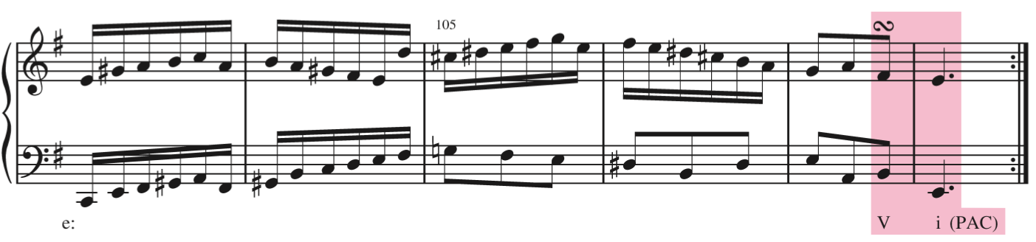
Authentic Cadences
Authentic Cadences
Tonic chord preceded by some version of V or viiº
Types of Authentic Cadences
Perfect Authentic Cadence (PAC)
V⁽⁷⁾ to I progression where both chords are in root position and ^1 (tonic) is in the soprano for the I chord.

Slide 5
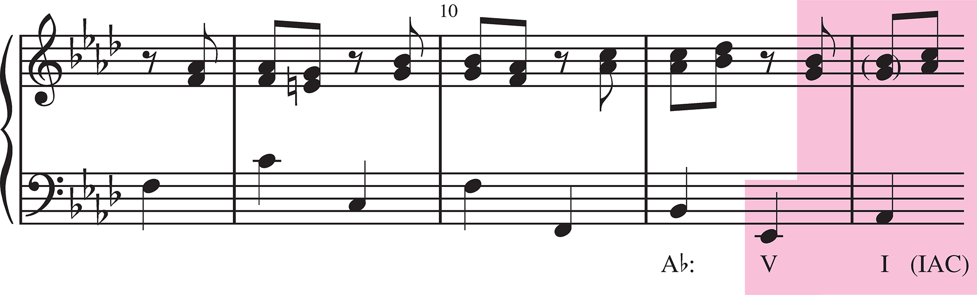
Authentic Cadences
Imperfect Authentic Cadence (IAC)
Any Authentic Cadence that is not a PAC
Root Position IAC – ^3 or ^5 in the soprano for the I chord.
Inverted IAC – one or both of the chords is in inversion
Leading-tone IAC: Some form of viiº–I, the viiº substituting for a V chord

Slide 6
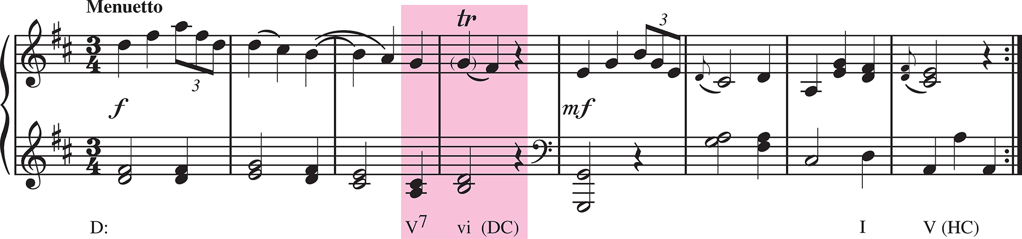
Other types of Cadences
Deceptive Cadence (DC): when we expect to hear V-I cadence but but we hear V-? (something else).
The ? is most often the submediant (vi or VI) triad.
Remember that other resolutions are possible

Slide 7
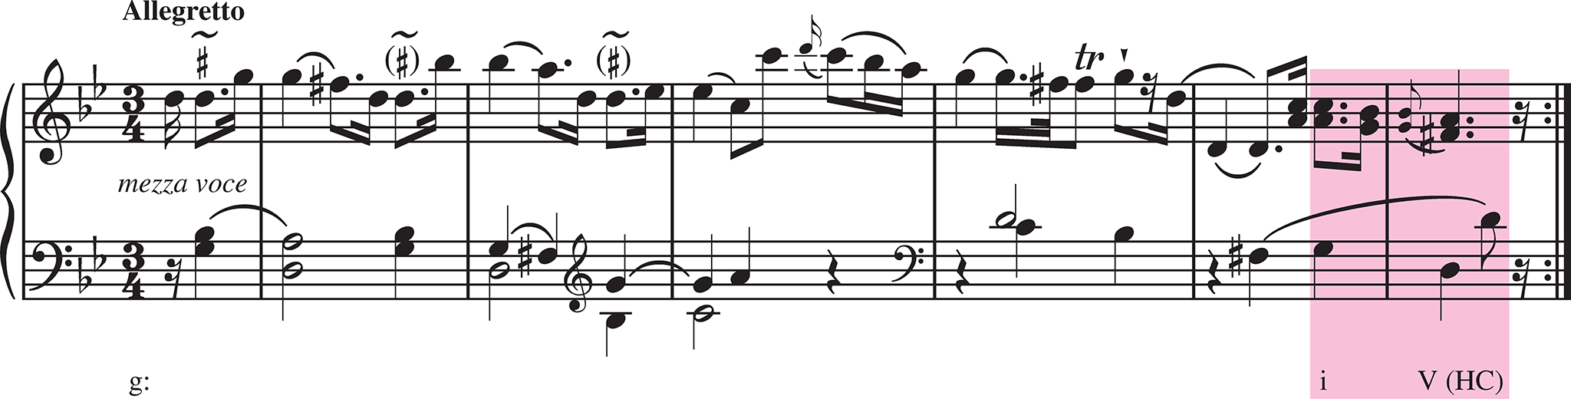
Other types of Cadences
Half Cadence (HC): a very common type of unstable or progressive cadence.
Ends with V
V can be preceded by any other chord
?-V

Slide 8
Cadence Review
Conclusive
Progressive
Cadence Type | First Chord | Second Chord
Authentic | Contains leading tone | Tonic
Plagal | Does not contain leading tone | Tonic
Cadence Type | First Chord | Second Chord
Deceptive | Contains leading tone | Not Tonic
Half | Does not contain leading tone | Not Tonic

Slide 9
Building Blocks of Form
Motives
Phrases
Periods
Sentences

Slide 10
Motives
Motive: the smallest identifiable musical idea.
A motive can consist of a:
Pitch Pattern
Rhythmic Pattern
Pitch & Rhythmic Pattern
Motives typically come back again & again and are developed throughout a piece.
They are most effective when readily identifiable
Let’s look at a famous one:

Slide 11
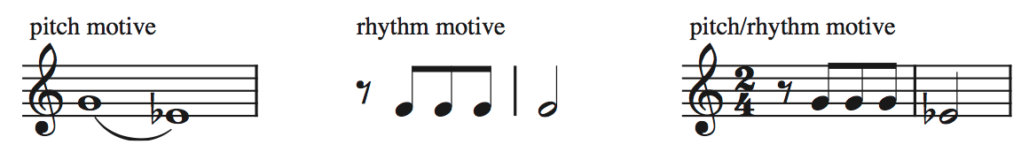
Motive
A Famous Example:

Slide 12
Phrases
Phrase: a relatively independent musical idea that ends with a cadence.
Sub-Phrase: a distinct portion of a phrase, that is not independent in its own right
Think of a phrase as a complete musical thought.
As performers, when we discuss phrasing what do we mean?
We often talk about the shape of a phrase (or independent idea). How we present an idea affects its meaning.
Ex. : I love phrases! vs. I love phrases?

Slide 13
Phrases
We label phrases with lowercase letters: a, b, c, d
Add ’ to a phrase label to indicate that it is similar material
Ex: the phrase a returns but is slightly different, we label it as a’
(a-prime)
Identifying phrases can be subjective
What sounds like a sub-phrase to you may sound like a complete phrase to another.
Ex: Mozart, Minuet No. 4 from 8 Minuets, KV 315g

Slide 14
Periods
Period: a group of two phrases in an antecedent-consequent relationship.
Question-Answer
What’s your favorite class?
Harmony I, of course!
The first phrase must end in a way that somehow leads to the next phrase
i.e. the first cadence must be less final than the second cadence
Examples:
Progressive than Conclusive cadence
IAC then PAC

Slide 15
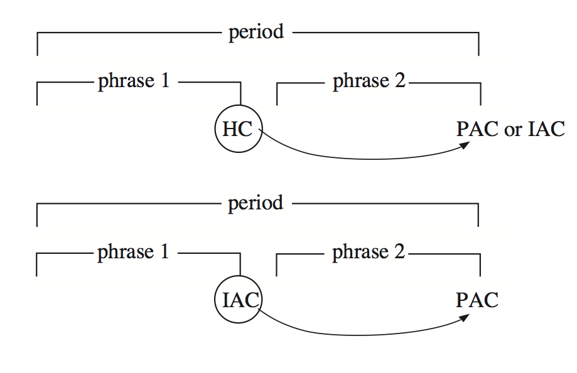
Periods

Slide 16
Periods
If both phrases are identical, it is not a period, it is a repeated phrase.
The endings of each phrase MUST DIFFER.
Parallel Period: a period where both phrases begin with similar or identical material, but end differently.
Contrasting Period: a period where the phrase beginnings differ

Slide 17
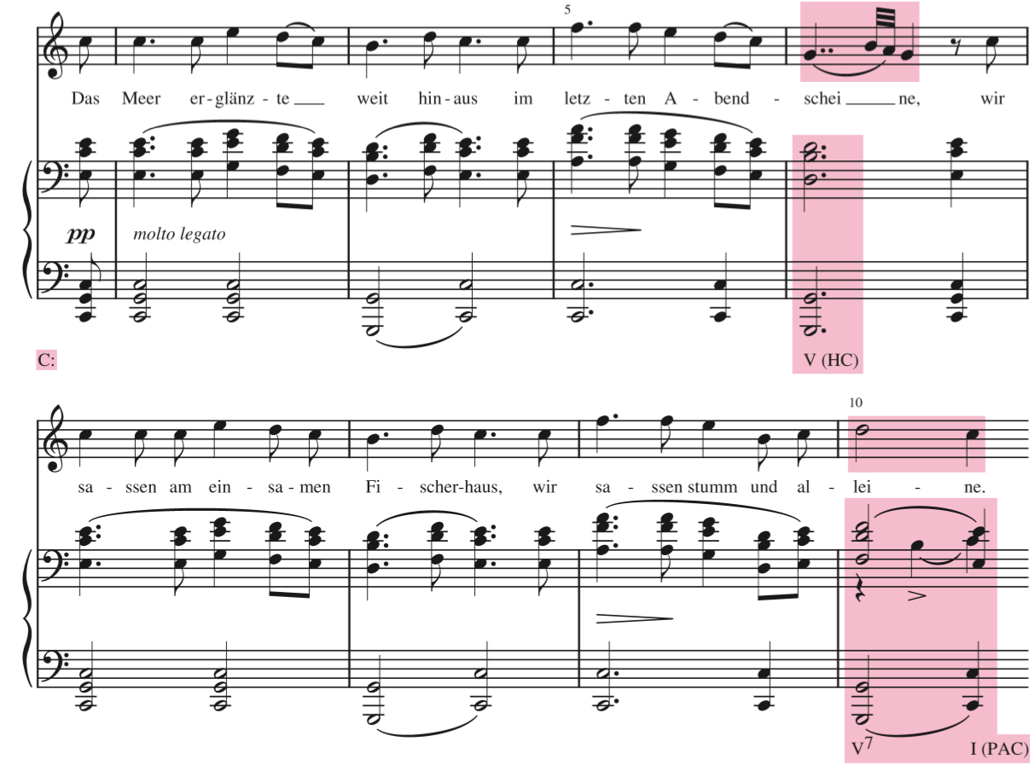
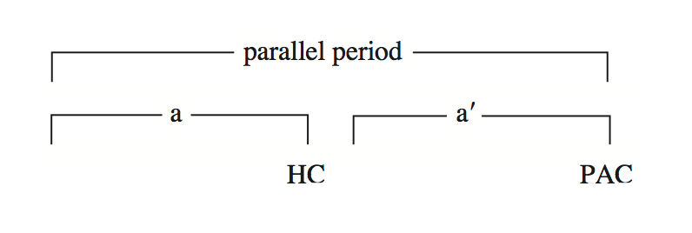
Schubert, Am Meer

Slide 18
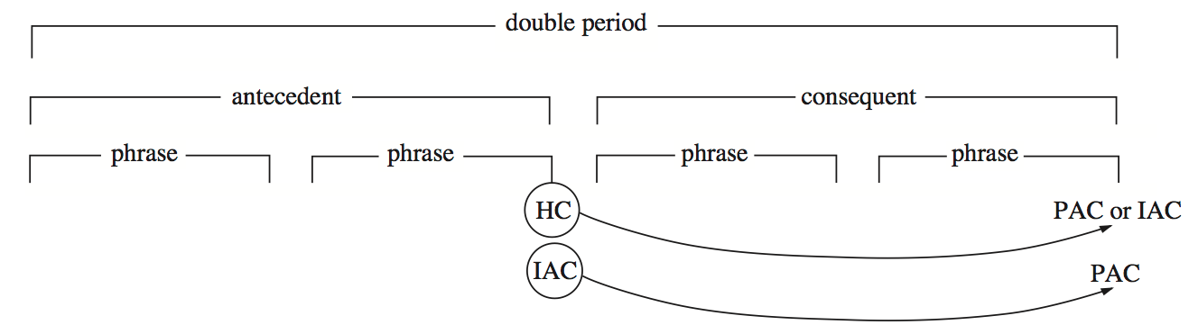
Periods
Double Period: consists typically of four phrases in two pairs
the cadence at the end of the second pair being stronger than the cadence at the end of the first pair

Slide 19
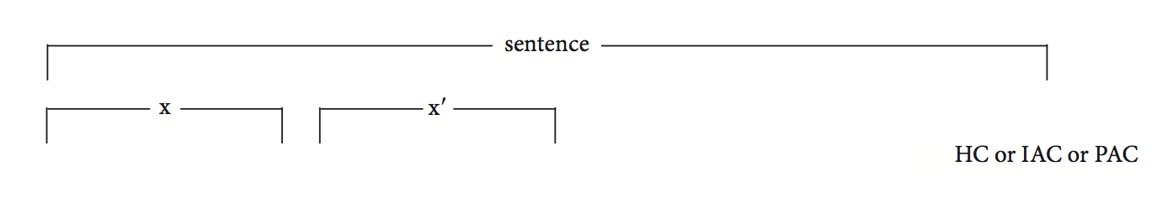
Sentences
Periods are defined by the weak to strong succession of cadences.
However, it is possible to large structure units with other cadential patterns.
Sentence: a structural unit that is characterized by the immediate repetition or variation of a musical idea followed by a motion toward a cadence.
Typically a single phrase in length.
anything goes
motion towards cad.
almost

Slide 20
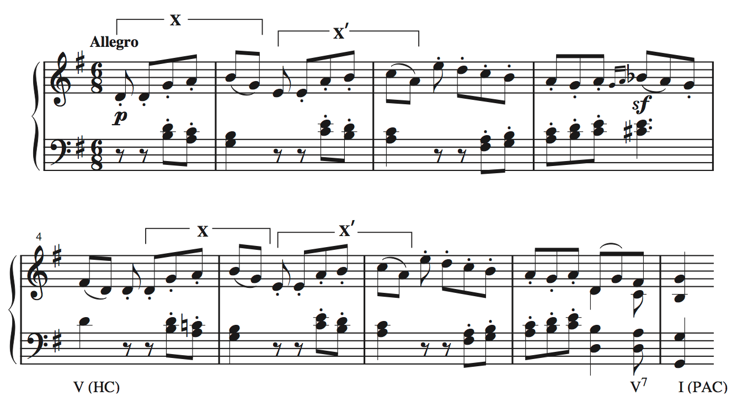
Beethoven, Piano Sonata op. 49

Slide 21
Chapter 10 recap
Cadences
Conclusive vs Progressive
Does the penultimate chord contain the leading tone?
Motives
Smallest identifiable musical idea
Phrases
Independent idea that ends with cadence
Period
Groups of phrases that are defined by a weak to strong cadential pattern.
Sentences
A structural unit define by repetition and/or variation of a musical idea, NOT a specific pattern of cadences.

